Slide 1
Final Pre
-- 25Fall BPS5231 AI for Sustainable Building Design
Kefan Chen, Guanli Feng
Nov 19, 2025

Slide 2
Problem Description
Methodology – Optimize control strategy, Create Dataset, Train surrogate model, Apply to physical case
Results

Slide 3
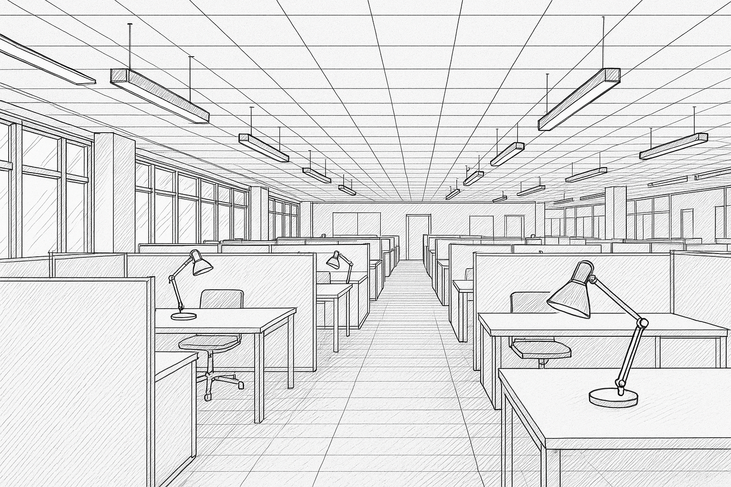
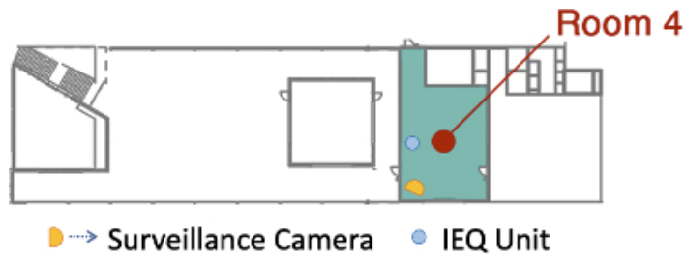
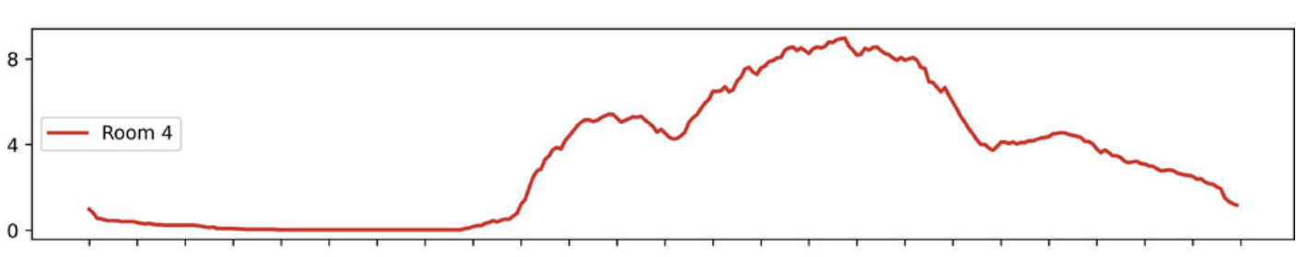
Problem Description
Modern buildings mainly rely on center background systems
While Personalized Environmental Control Systems (PECS) allow individuals to customize indoor individual micro-environment.
Problem Identification
Background system –> general space control PECS –> micro-environment of occupants
➡️ But occupants come and leave ➡️ If there's a better controlling strategy corresponding to changing occupancy condition?
Research Question/Hypothesis
1 > Optimization on light control and energy: Under different occupant distribution conditions, could we design an integrated framework that combines PECS and background system control on lighting to maintain/improve occupants' visual light comfort and save lighting energy consumption?
2 > Case study on real occupancy historical data of BEE Hub: Could we utilize ML tools (like surrogate model thinking) to apply such control strategy on different occupant distribution in an accurate and low time-consuming way? Then we could combine it with historical occupancy data to visualize its energy saving potential.
GPT5-generated diagram
Tekler, Z.D., Ono, E., Peng, Y. et al. ROBOD, room-level occupancy and building operation dataset. Build. Simul. 15, 2127–2137 (2022). https://doi.org/10.1007/s12273-022-0925-9

Slide 4
Problem Description
Methodology – Optimize control strategy, Create Dataset, Train surrogate model, Apply to physical case
Results

Slide 5
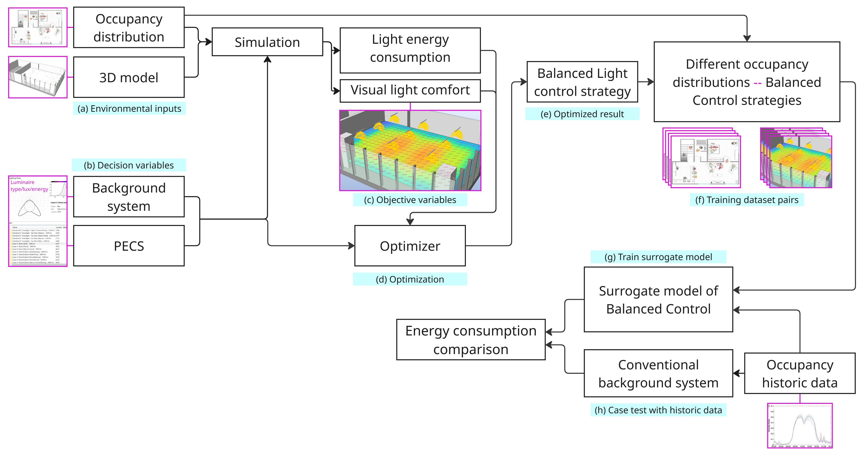
Methodology – Optimize control strategy, Create Dataset, Train surrogate model, Apply to physical case

Slide 6
Methodology – Optimize control strategy, Create Dataset, Train surrogate model, Apply to physical case

Slide 7
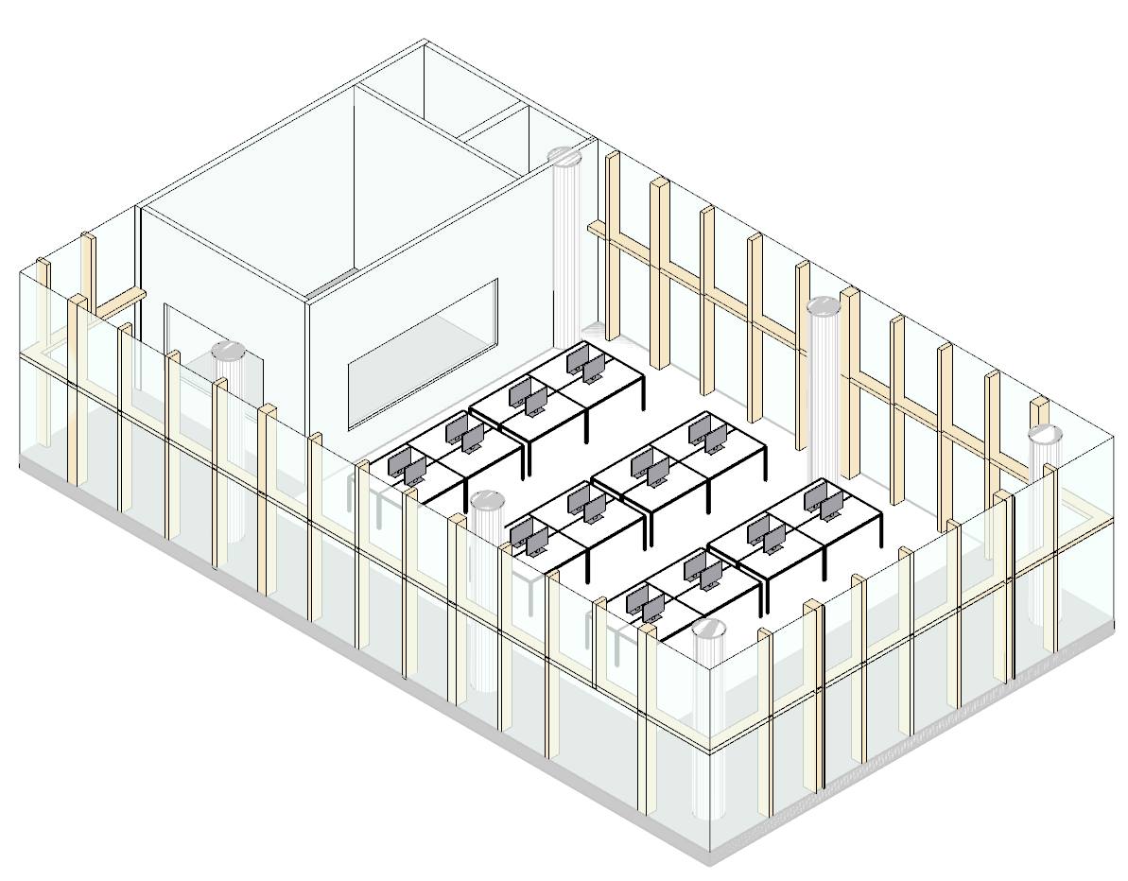
Methodology – Optimize control strategy, Create Dataset, Train surrogate model, Apply to physical case
(a) Environmental inputs of BEE Hub
Occupancy distribution: Randomly generate occupant distribution on designed seats (max possibility= 2^n, n = 24)
3D model: BEE Hub

Slide 8
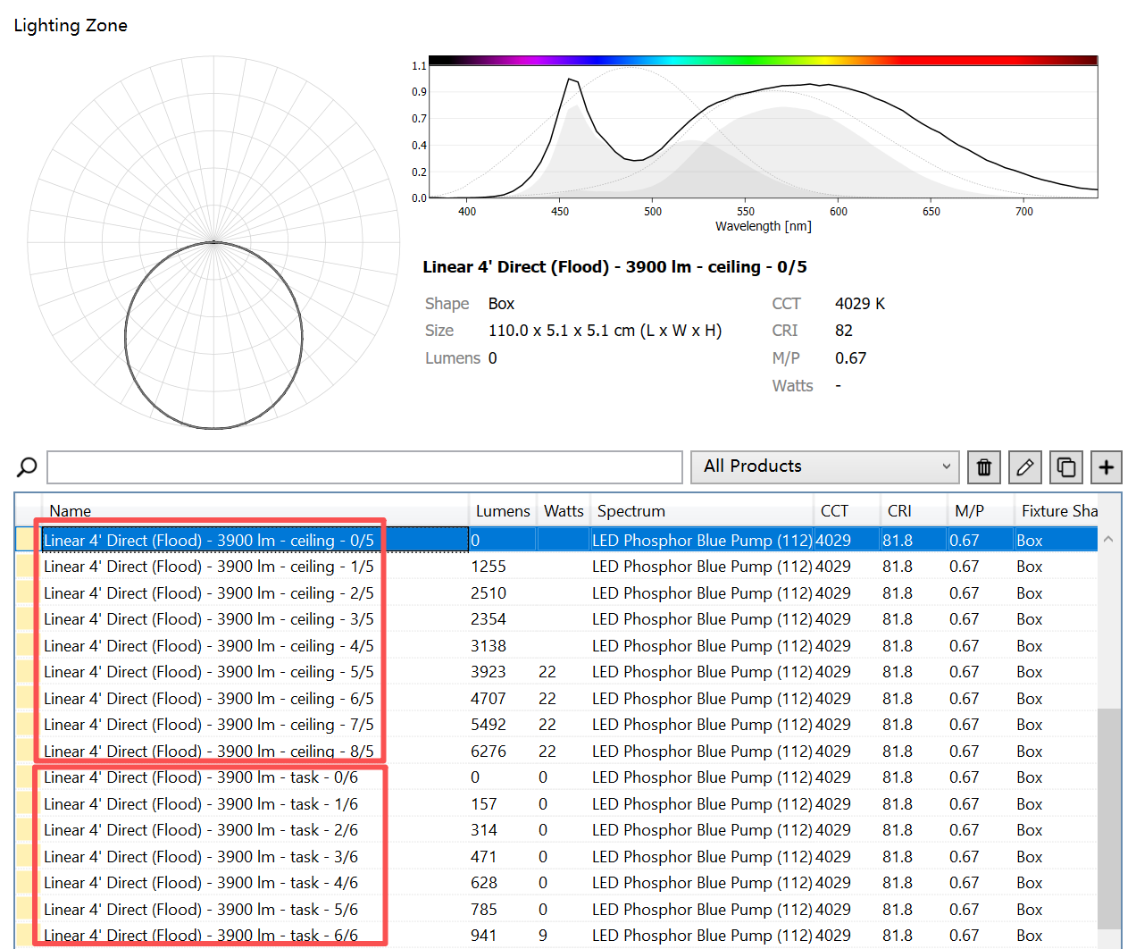
Methodology – Optimize control strategy, Create Dataset, Train surrogate model, Apply to physical case
(b) Decision variables
Background system & Task light: Level inputs of ceiling and task lights – Lumen & Power

Slide 9
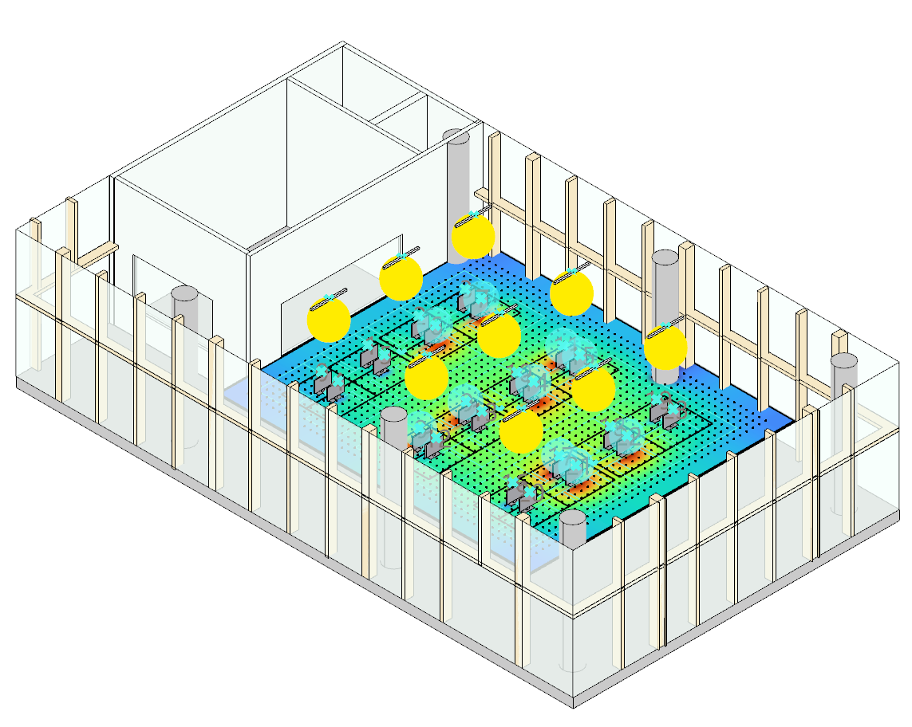
Methodology – Optimize control strategy, Create Dataset, Train surrogate model, Apply to physical case
(b) Decision variables
Background system & Task light: Level inputs of ceiling and task lights – Lumen & Power

Slide 10
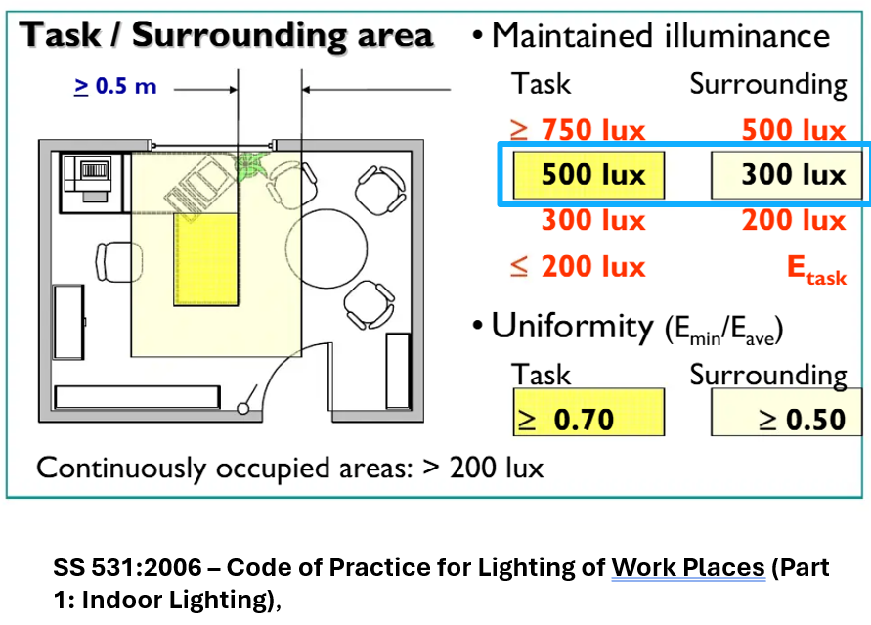
Methodology – Optimize control strategy, Create Dataset, Train surrogate model, Apply to physical case
(c) Objective variables
Light energy consumption: The parameter that we want to minimize
Visual light comfort: Quantify from electric lighting simulation The restriction we need to follow

Slide 11
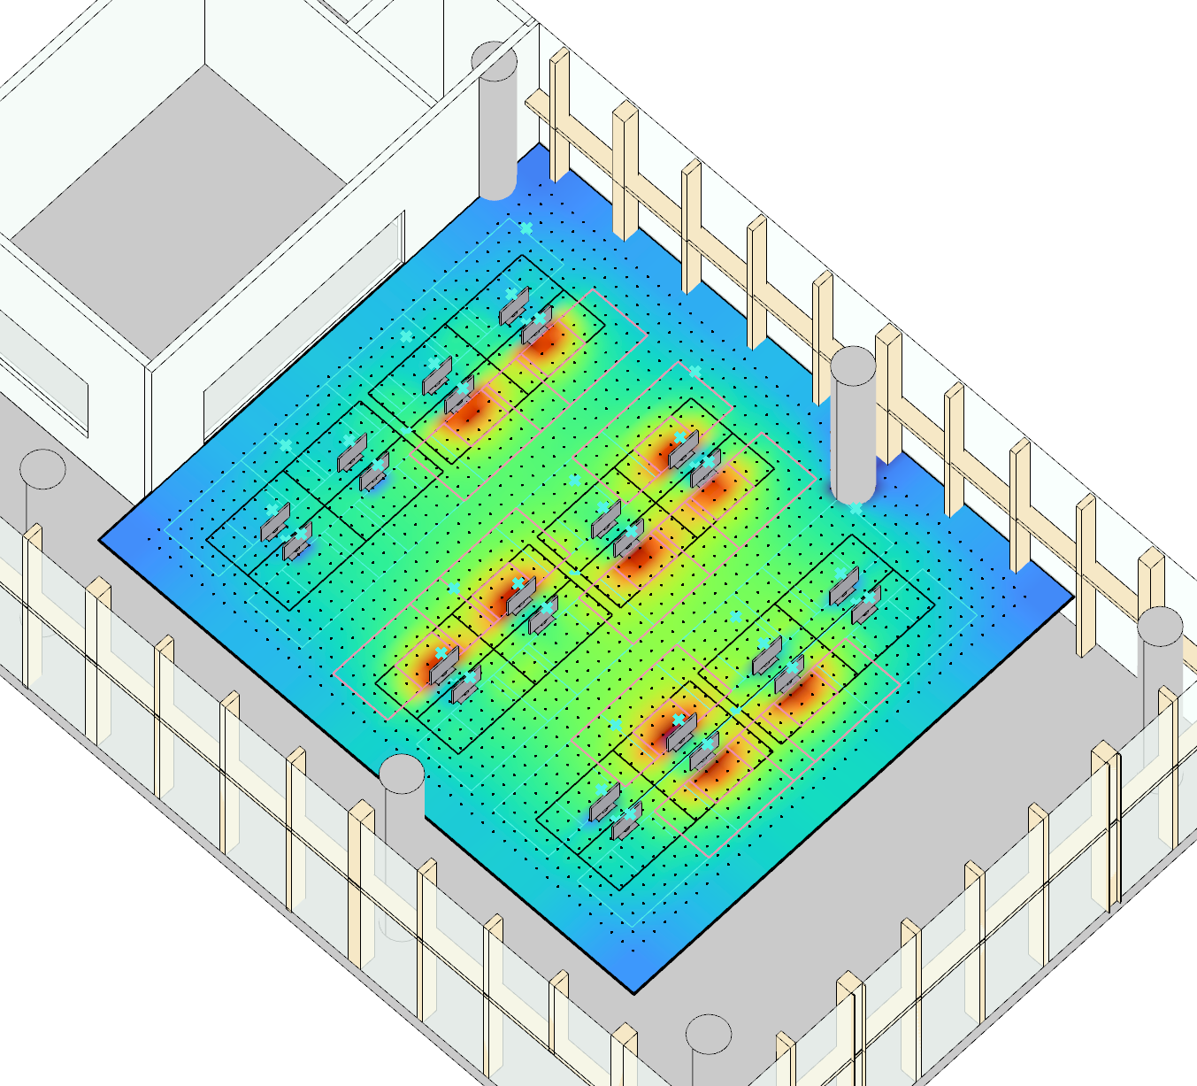

Methodology – Optimize control strategy, Create Dataset, Train surrogate model, Apply to physical case
(c) Objective variables
Light energy consumption: The parameter that we want to be lower
Visual light comfort: Quantify from electric lighting simulation The restriction we need to follow

Slide 12
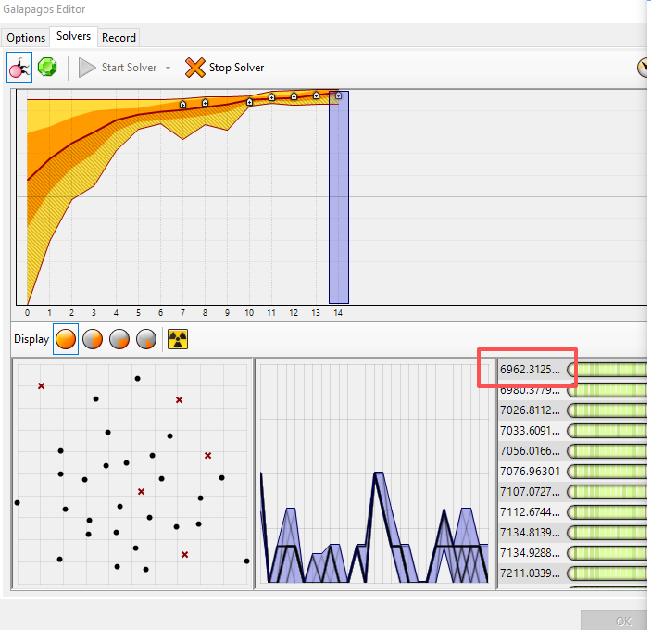
Methodology – Optimize control strategy, Create Dataset, Train surrogate model, Apply to physical case
(d) Optimization Min(Power + Penalty (luminance and uniformity))
Galapagos Algorithm

Slide 13

Methodology – Optimize control strategy, Create Dataset, Train surrogate model, Apply to physical case
(e) Optimized result
The balanced light control strategy based on inputted occupant distribution

Slide 14
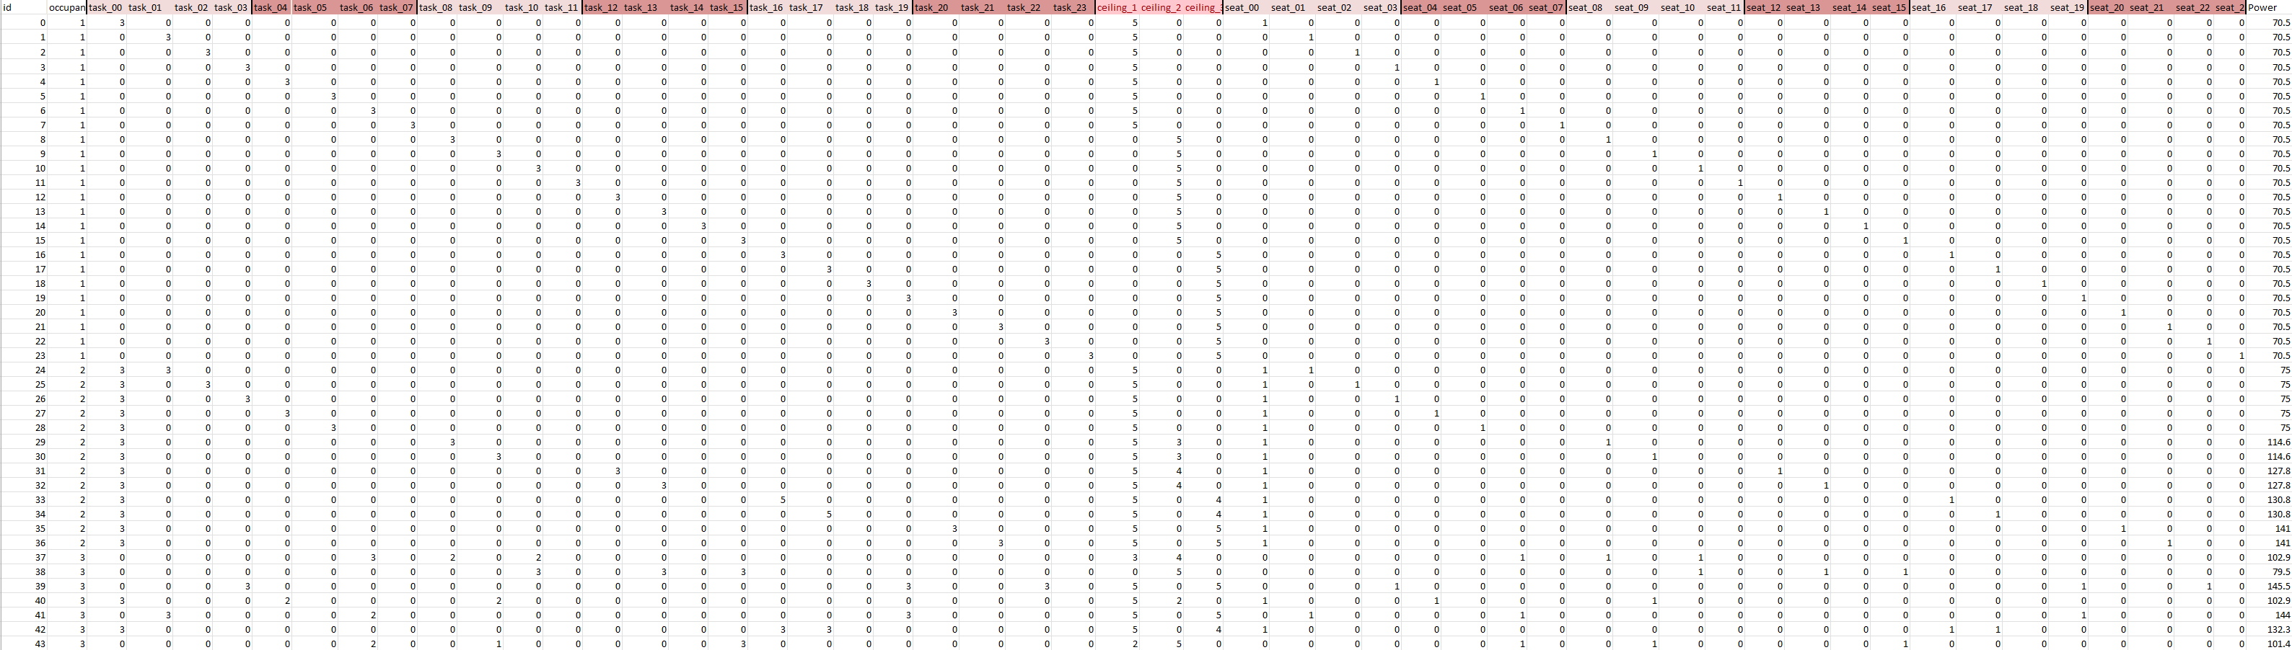
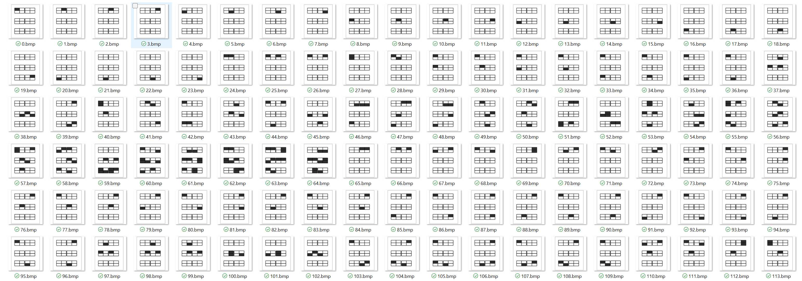
Methodology – Optimize control strategy, Create Dataset, Train surrogate model, Apply to physical case
(f) Training dataset pairs
The balanced light control strategy based on inputted occupant distribution (1094 pairs)
Lighting control – Occupant distribution

Slide 15
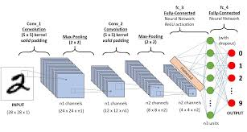
Methodology – Optimize control strategy, Create Dataset, Train surrogate model, Apply to physical case
FOR GUANLI模型原理解释 可以用Netron
Model structure
类似这样示意一下
图片+座位
(g) Train surrogate model
Use ML tools

Slide 16
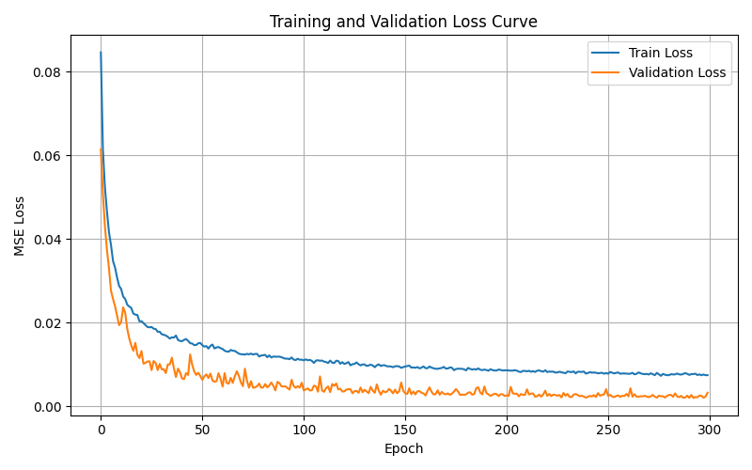
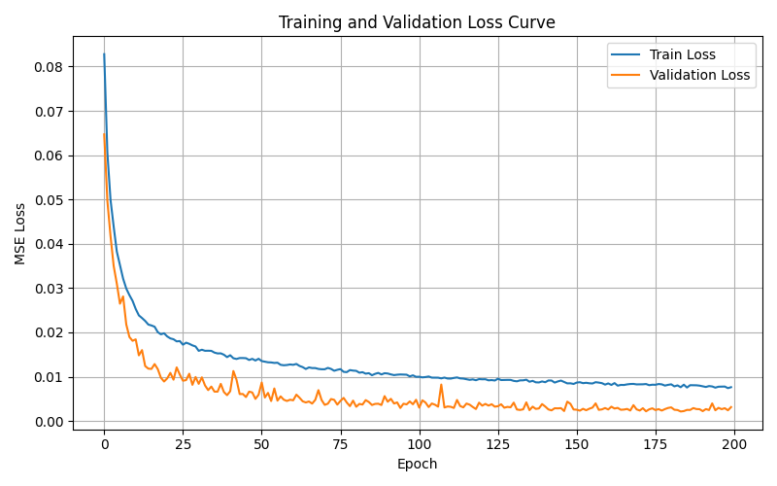
Methodology – Optimize control strategy, Create Dataset, Train surrogate model, Apply to physical case
BATCH_SIZE = 32
NUM_EPOCHS = 300
LEARNING_RATE = 1e-3
VAL_SPLIT = 0.2
BATCH_SIZE = 32
NUM_EPOCHS = 200
LEARNING_RATE = 1e-3
VAL_SPLIT = 0.2
(g) Train surrogate model
Training

Slide 17
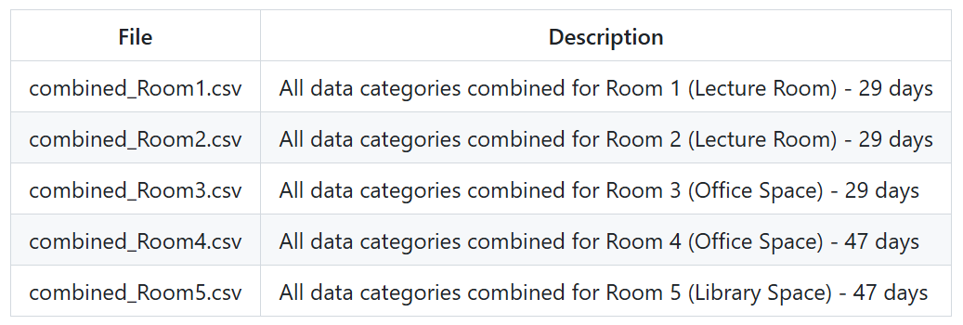
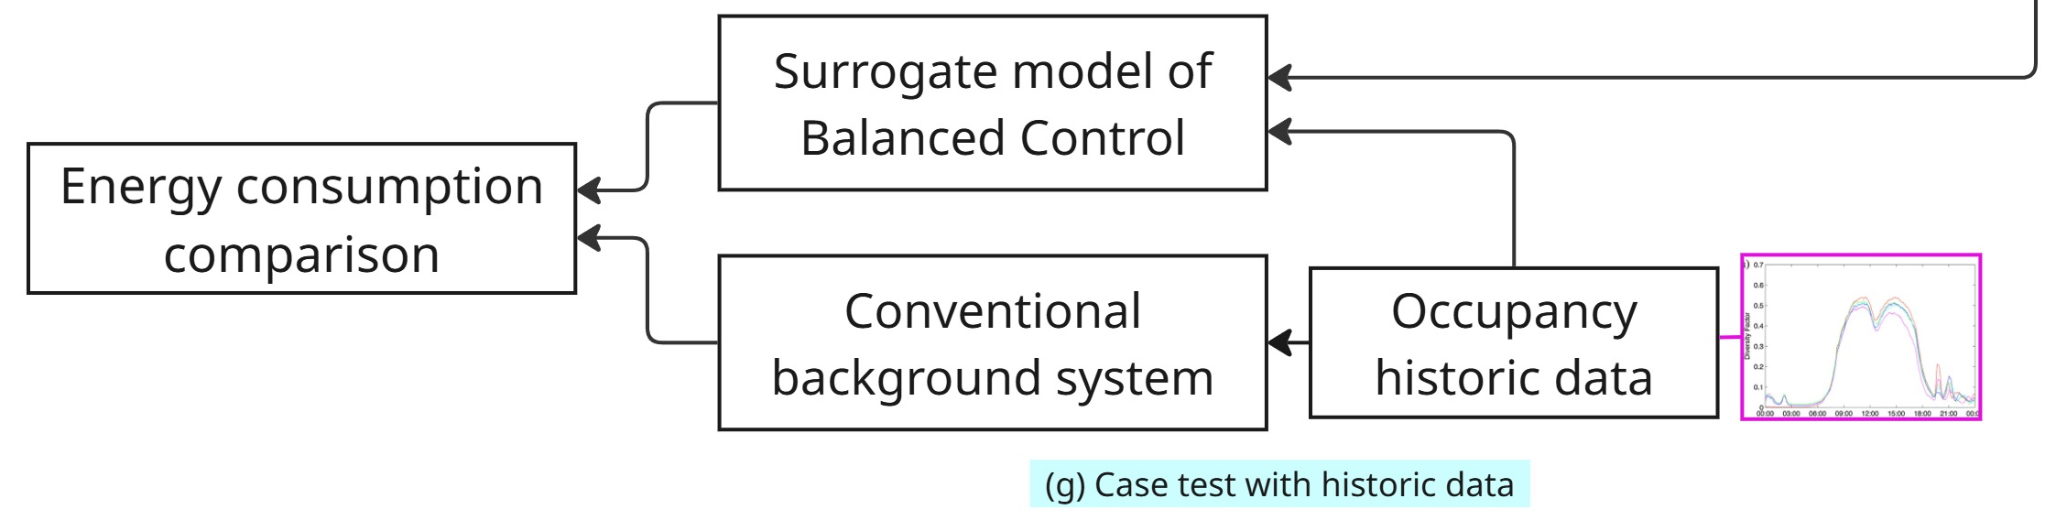
Methodology – Optimize control strategy, Create Dataset, Train surrogate model, Apply to physical case
Average occupant count for BEE Hub on an average day. Tekler, Z.D., Ono, E., Peng, Y. et al. ROBOD, room-level occupancy and building operation dataset. Build. Simul. 15, 2127–2137 (2022). https://doi.org/10.1007/s12273-022-0925-9
(h) Case test on historical data
The occupancy data of BEE Hub (link) Then apply trained surrogate model and compare the energy performance with solely use background light

Slide 18
Problem Description
Methodology – Optimize control strategy, Create Dataset, Train surrogate model, Apply to physical case
Results – Saving potential

Slide 19
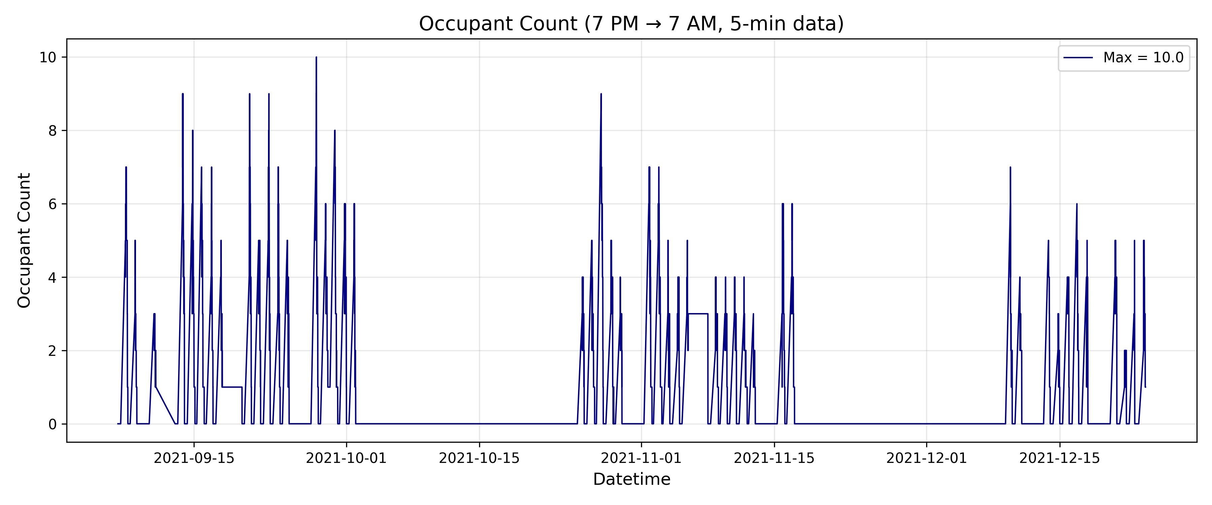
Results – Saving potential
Tekler, Z.D., Ono, E., Peng, Y. et al. ROBOD, room-level occupancy and building operation dataset. Build. Simul. 15, 2127–2137 (2022). https://doi.org/10.1007/s12273-022-0925-9

Slide 20
Results – Saving potential
Tekler, Z.D., Ono, E., Peng, Y. et al. ROBOD, room-level occupancy and building operation dataset. Build. Simul. 15, 2127–2137 (2022). https://doi.org/10.1007/s12273-022-0925-9

Slide 21
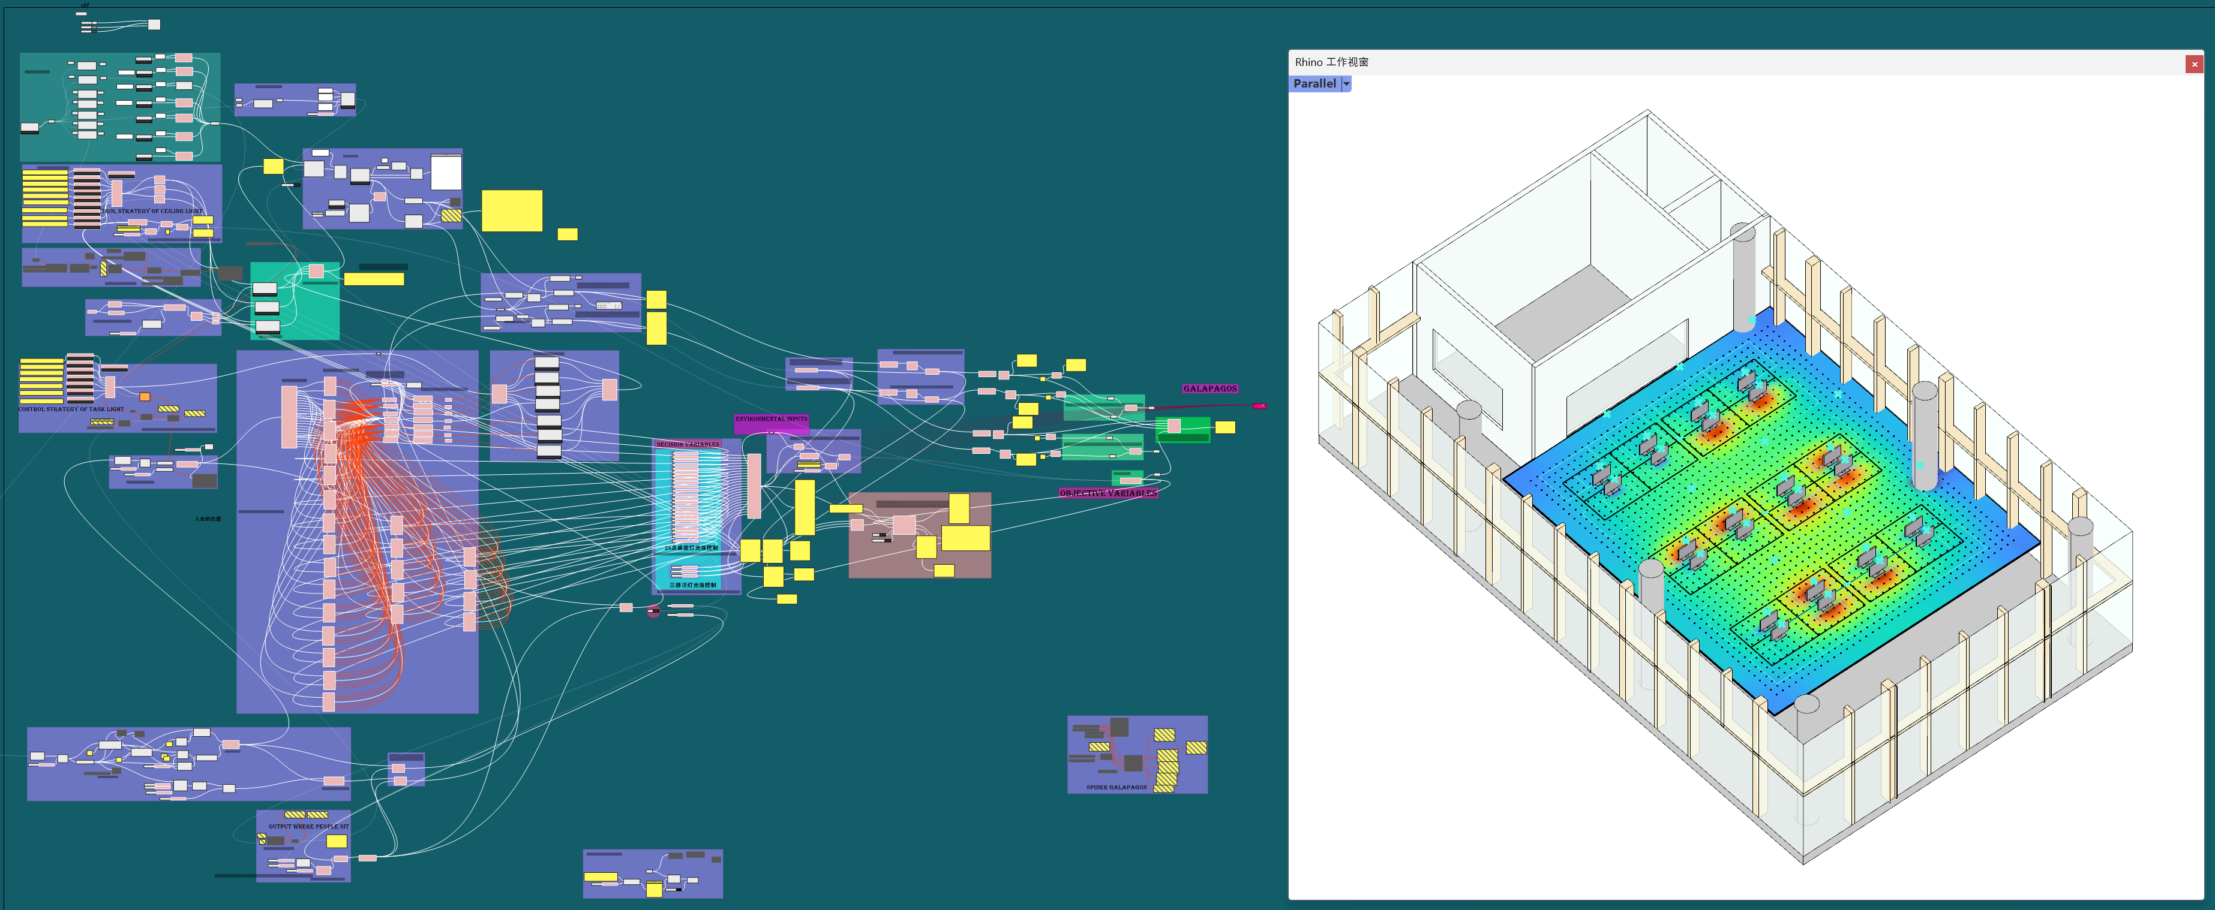
Thanks:)

